Slide 1
Quality of Service Support
QoS
#<number>

Slide 2
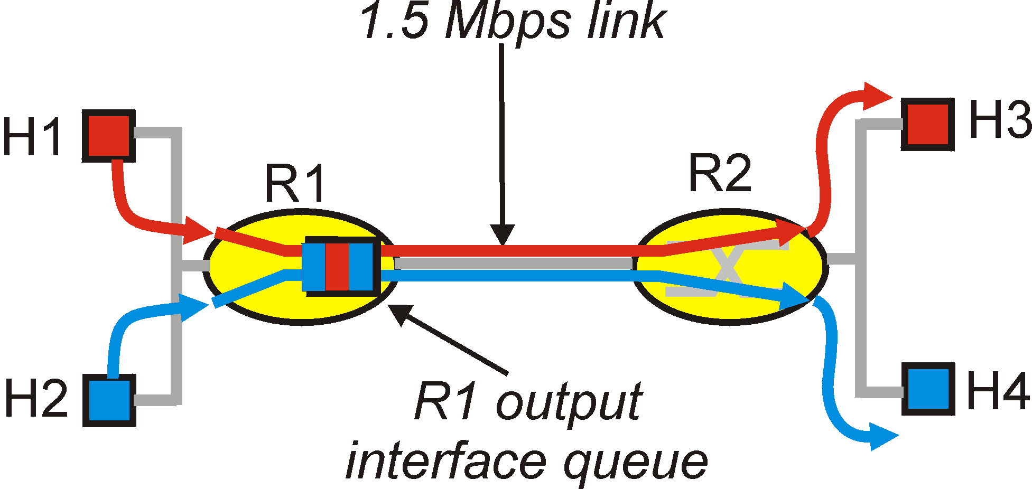
QOS in IP Networks
IETF groups are working on proposals to provide QOS control in IP networks, i.e., going beyond best effort to provide some assurance for QOS
Work in Progress includes RSVP, Differentiated Services, and Integrated Services
Simple model
for sharing and
congestion
studies:
QoS
#<number>

Slide 3
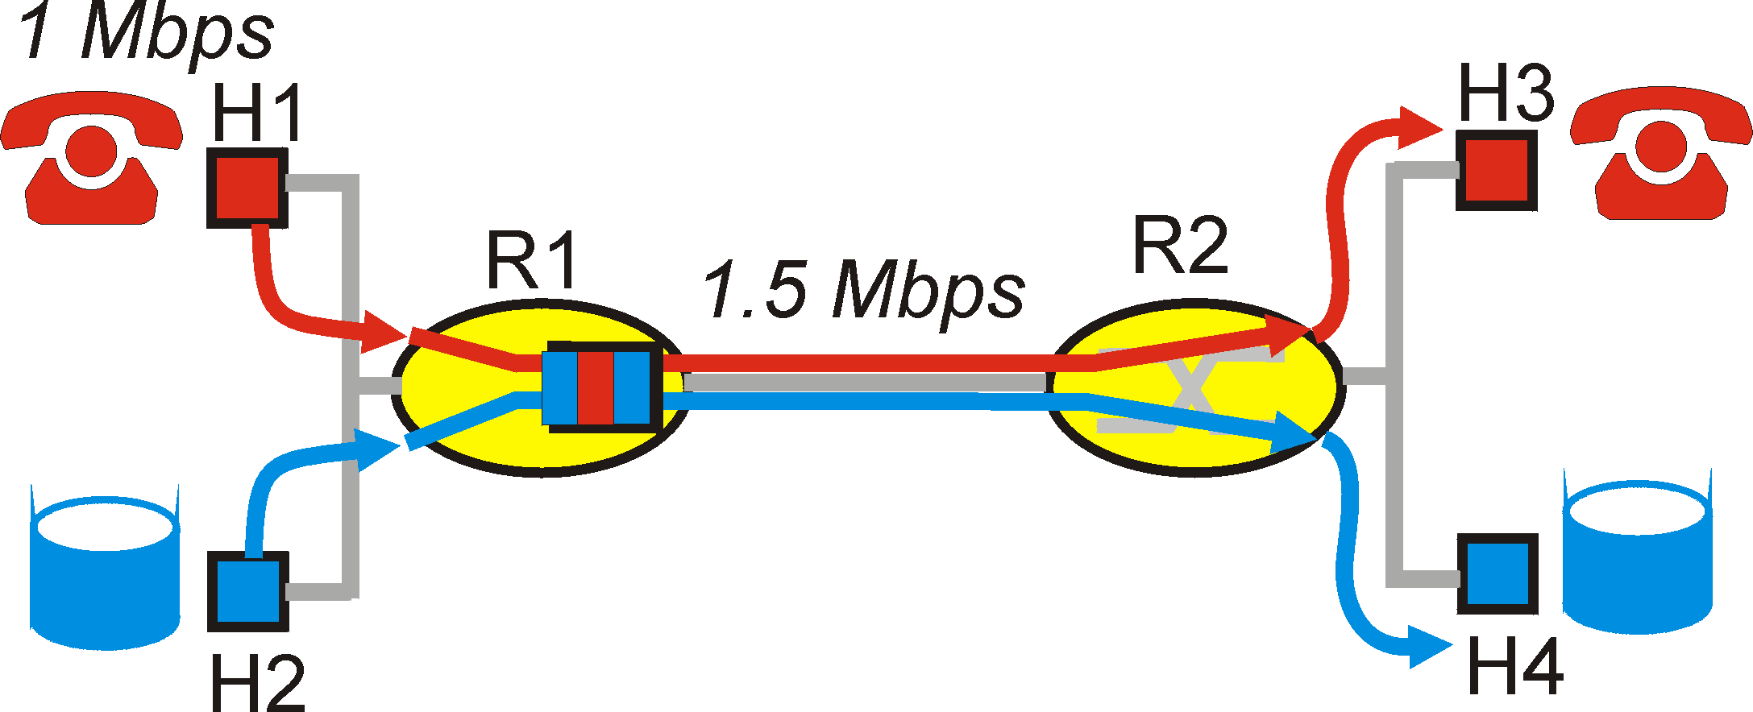
Principles for QOS Guarantees
Consider a phone application at 1Mbps and an FTP application sharing a 1.5 Mbps link.
  bursts of FTP can congest the router and cause audio packets to be dropped.
  want to give priority to audio over FTP
PRINCIPLE 1: Marking of packets is needed for router to distinguish between different classes; and new router policy to treat packets accordingly
QoS
#<number>

Slide 4
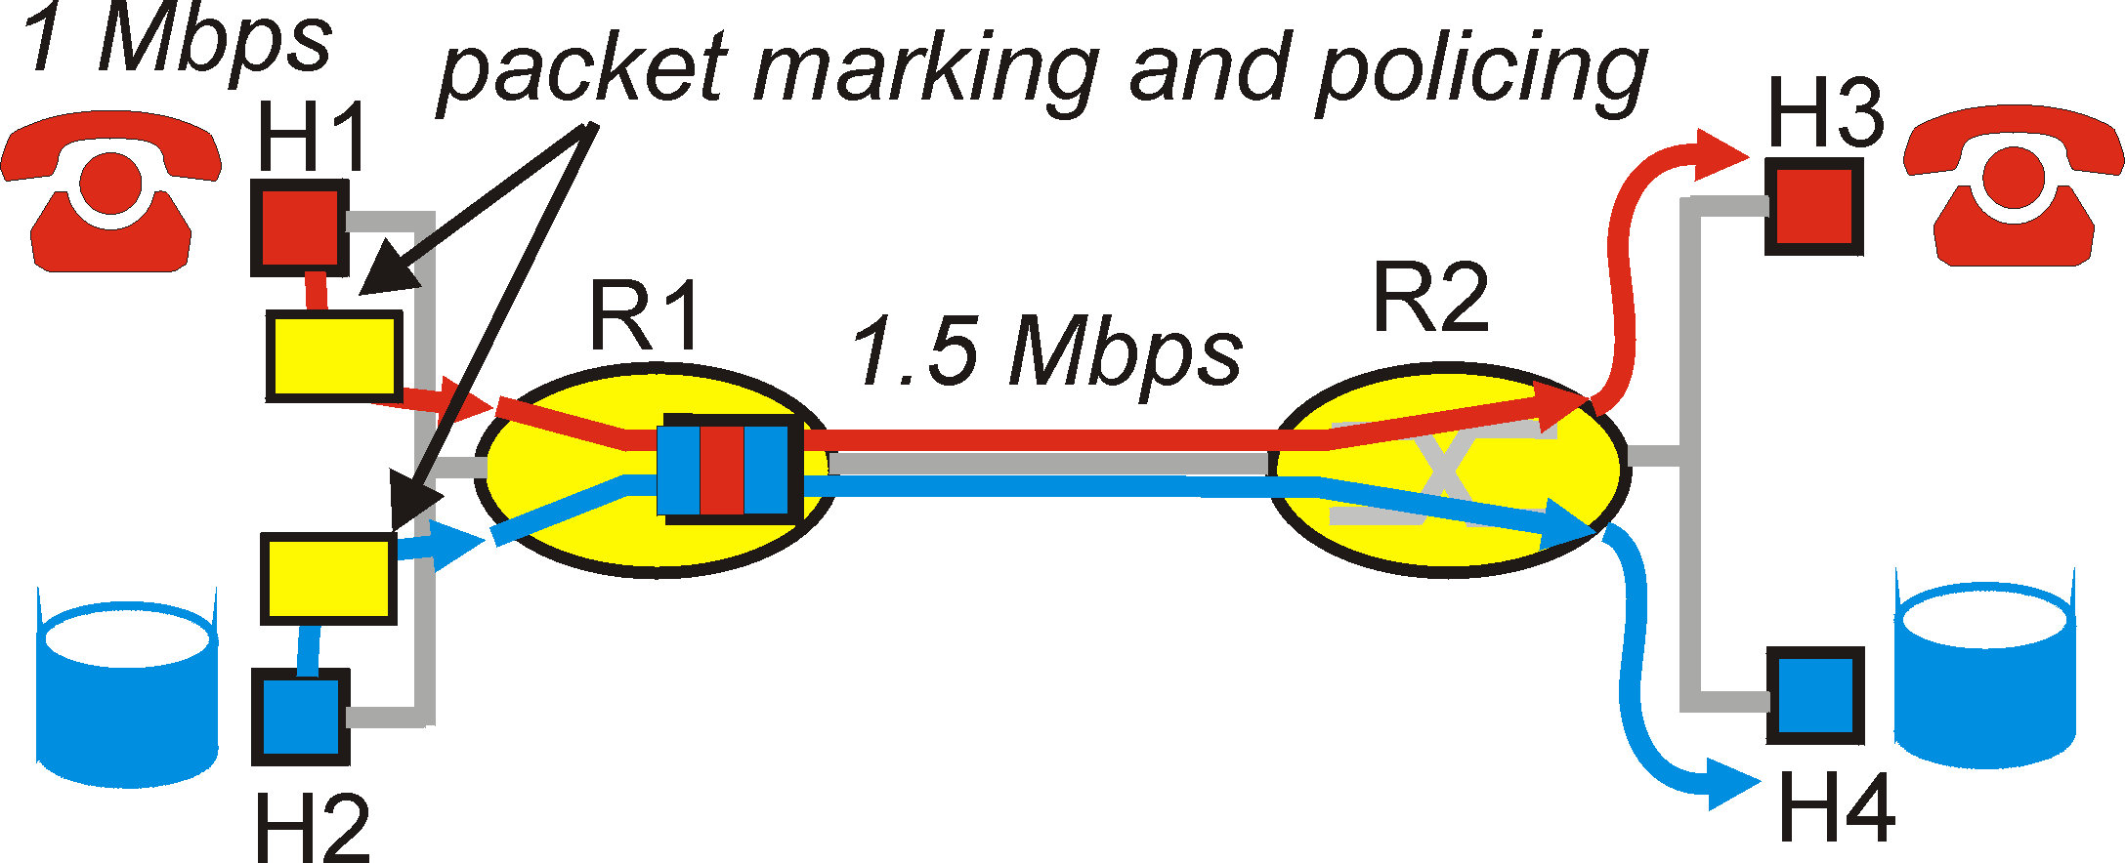
Principles for QOS Guarantees (more)
Applications misbehave (audio sends packets at a rate higher than 1Mbps assumed above);
PRINCIPLE 2: provide protection (isolation) for one class from other classes
Require Policing Mechanisms to ensure sources adhere to bandwidth requirements; Marking and Policing need to be done at the edges:
QoS
#<number>

Slide 5
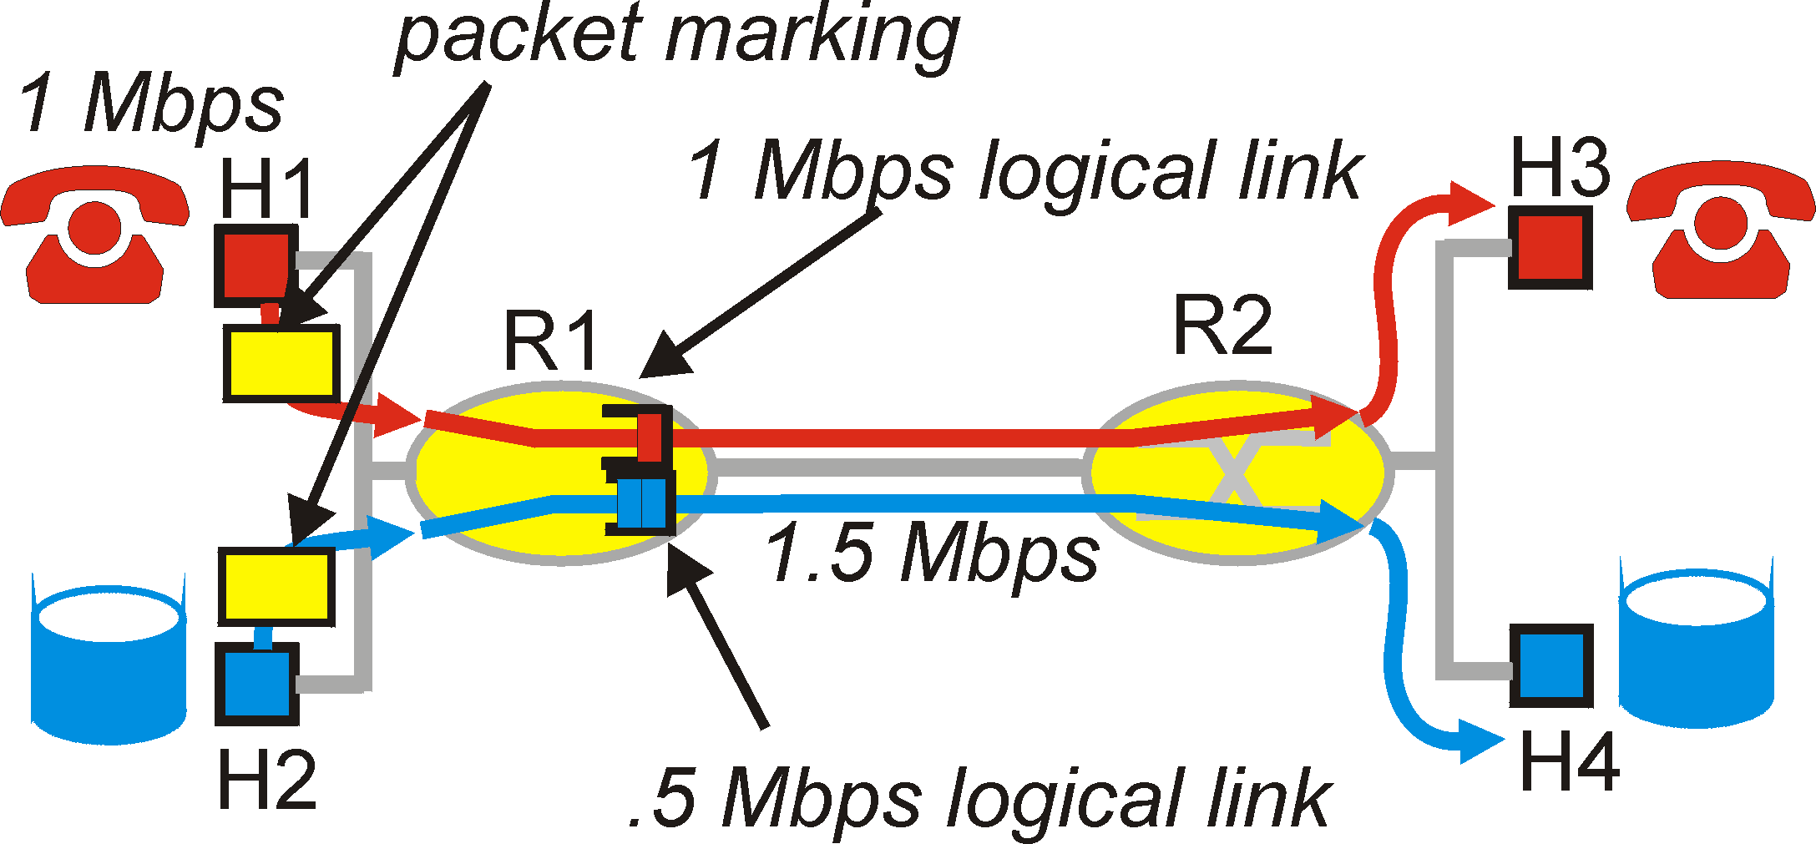
Principles for QOS Guarantees (more)
Alternative to Marking and Policing: allocate a set portion of bandwidth to each application flow; can lead to inefficient use of bandwidth if one of the flows does not use its allocation
PRINCIPLE 3: While providing isolation, it is desirable to use resources as efficiently as possible
QoS
#<number>

Slide 6
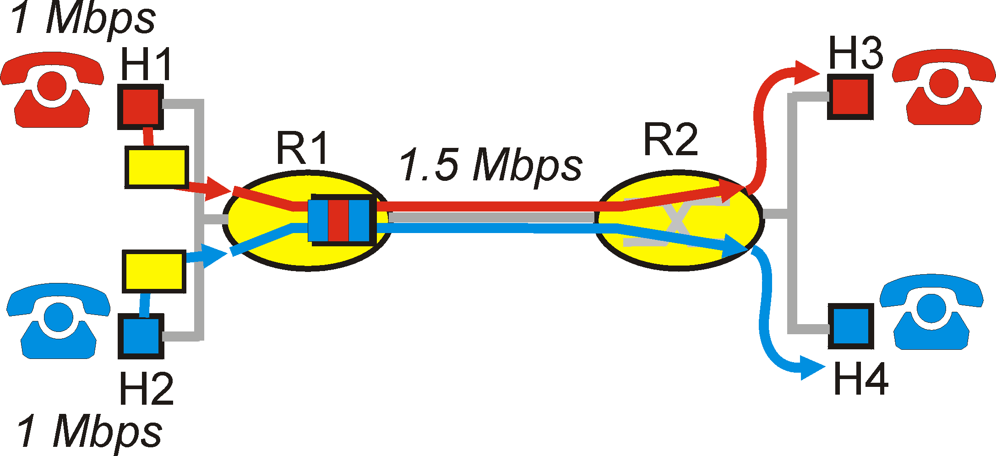
Principles for QOS Guarantees (more)
Cannot support traffic beyond link capacity
  Two phone calls each requests 1 Mbps
PRINCIPLE 4: Need a Call Admission Process; application flow declares its needs, network may block call if it cannot satisfy the needs
QoS
#<number>

Slide 7
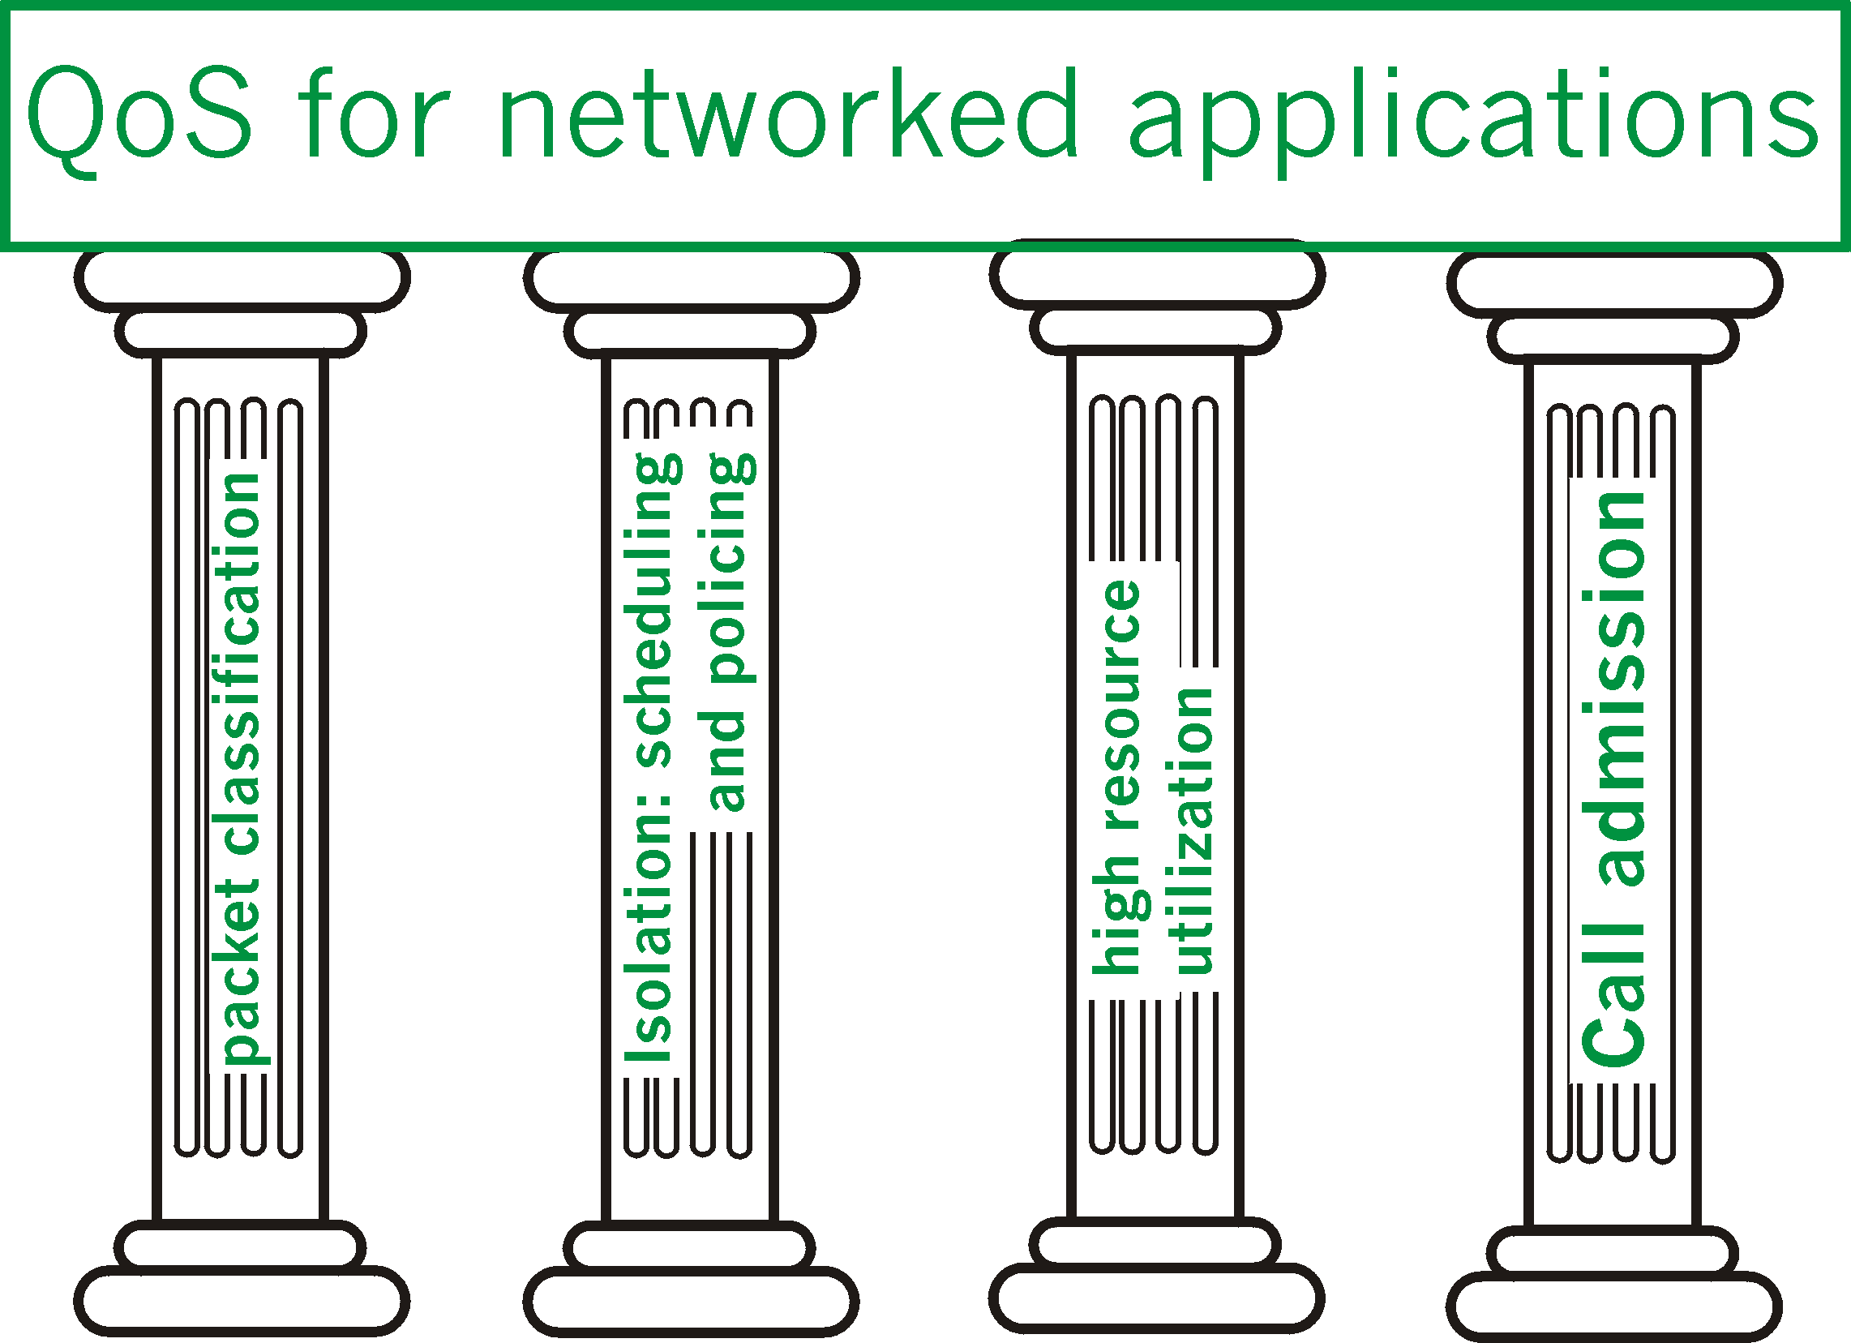
QoS
#<number>

Slide 8
Building blocks
Scheduling
  Active Buffer Management
Traffic Shaping
  Leaky Bucket
  Token Bucket
Modeling
  The (σ,ρ) Model
  WFQ and delay guarantee
Admission Control
  QoS Routing
QoS
#<number>

Slide 9
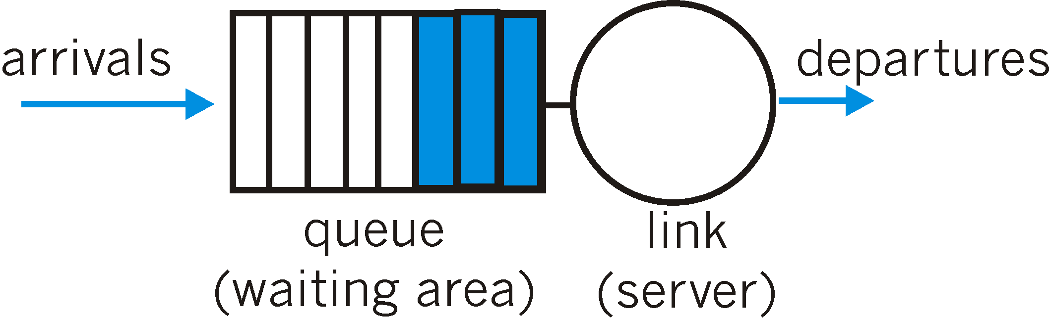
Scheduling: How Can Routers Help
Scheduling: choosing the next packet for transmission
  FIFO/Priority Queue
  Round Robin/ DRR
  Weighted Fair Queuing
  We had a lecture on that!
Packet dropping:
  not drop-tail
  not only when buffer is full
    Active Queue Management
Congestion signaling
  Explicit Congestion Notification (ECN)
QoS
#<number>

Slide 10
Buffer Size
Why not use infinite buffers?
  no packet drops!
Small buffers:
  often drop packets due to bursts
  but have small delays
Large buffers:
  reduce number of packet drops (due to bursts)
  but increase delays
Can we have the best of both worlds?
QoS
#<number>

Slide 11
Random Early Detection (RED)
Basic premise:
  router should signal congestion when the queue first starts building up (by dropping a packet)
  but router should give flows time to reduce their sending rates before dropping more packets
  Note: when RED is coupled with ECN, the router can simply mark a packet instead of dropping it
Therefore, packet drops should be:
  early: don’t wait for queue to overflow
  random: don’t drop all packets in burst, but space them
QoS
#<number>

Slide 12
RED
FIFO scheduling
Buffer management:
  Probabilistically discard packets
  Probability is computed as a function of average queue length (why average?)
Discard Probability
1
0
min_th
max_th
queue_len
Average
Queue Length
QoS
#<number>

Slide 13
RED (cont’d)
Discard
Discard Probability (P)
1
0
min_th
max_th
queue_len
Average
Queue Length
Enqueue
Discard/Enqueue
probabilistically
QoS
#<number>

Slide 14
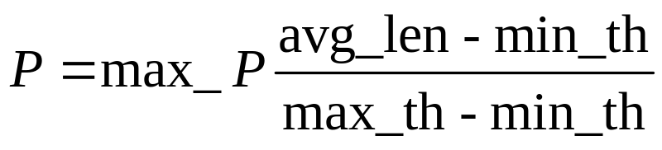
RED (cont’d)
Setting the discard probability P:
Discard Probability
max_P
1
P
0
min_th
max_th
queue_len
Average
Queue Length
avg_len
QoS
#<number>

Slide 15
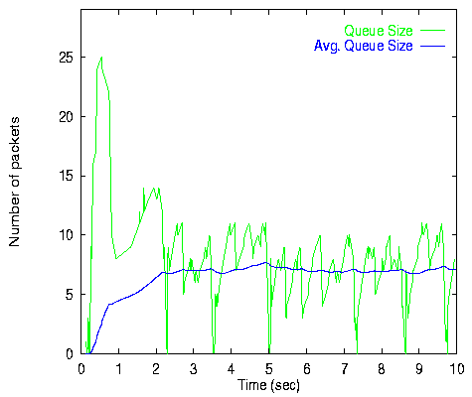
Average vs Instantaneous Queue
QoS
#<number>

Slide 16
RED and TCP
Sequence of actions (Early drop)
  Duplicate Acks
  Fast retransmit
    Session recovers
  Lower source rate
Fairness in drops
  Bursty versus non-Bursy
  Probability of drop depends on rate.
Disadvantages
  Many additional parameters
  Increasing the loss
QoS
#<number>

Slide 17
RED Summary
Basic idea is sound, but does not always work well
  Basically, dropping packets, early or late is a bad thing
High network utilization with low delays when flows are long lived
Average queue length small, but capable of absorbing large bursts
Many refinements to basic algorithm make it more adaptive
  requires less tuning
Does not work well for short lived flows (like Web traffic)
  Dropping packets in an already short lived flow is devastating
Better to mark ECN instead of dropping packets
  ECN not widely supported
QoS
#<number>

Slide 18
Traffic Shaping
Traffic shaping controls the rate at which packets are sent (not just how many).
  Used in ATM and Integrated Services networks.
At connection set-up time, the sender and carrier negotiate a traffic pattern (shape).
Two traffic shaping algorithms are:
  Leaky Bucket
  Token Bucket
QoS
#<number>

Slide 19
The Leaky Bucket Algorithm
The Leaky Bucket Algorithm
  used to control rate in a network.
  It is implemented as a single-server queue
    with constant service time.
  If the bucket (buffer) overflows then packets are discarded.
Leaky Bucket (parameters r and B):
  Every r time units: send a packet.
  For an arriving packet
    If queue not full (less than B) then enqueue
Note that the output is a “perfect” constant rate.
QoS
#<number>

Slide 20
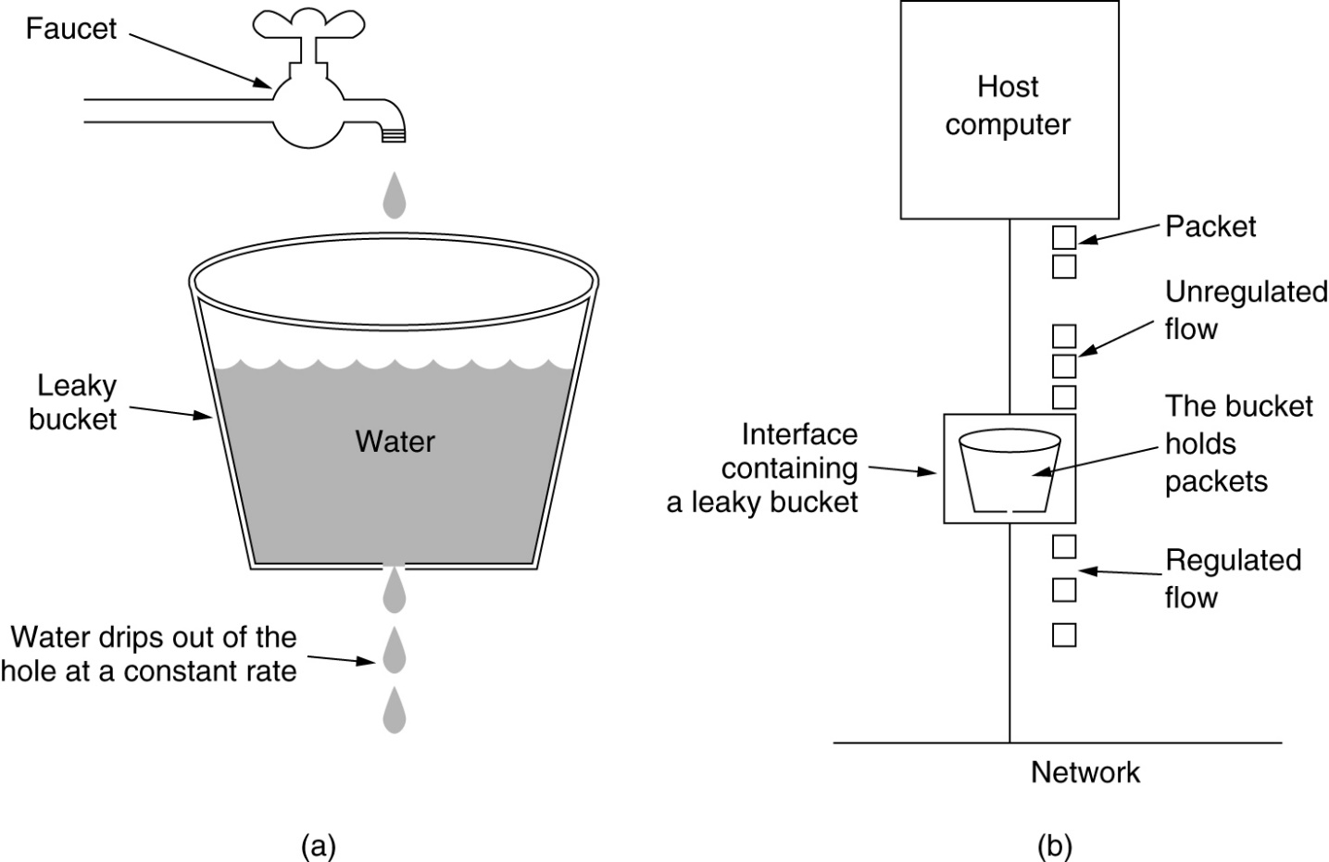
The Leaky Bucket Algorithm
(a) A leaky bucket with water. (b) a leaky bucket with packets.
QoS
#<number>

Slide 21
Token Bucket Algorithm
Highlights:
  The bucket holds tokens.
  To transmit a packet, we “use” one token.
Allows the output rate to vary,
  depending on the size of the burst.
  In contrast to the Leaky Bucket
Granularity
  Packets (or bits)
Token Bucket
(r, MaxTokens):
  Generate a token every r time units
    If number of tokens more than MaxToken, reset to MaxTokens.
  For an arriving packet: enqueue
  While buffer not empty and there are tokens:
    send a packet and discard a token
QoS
#<number>

Slide 22
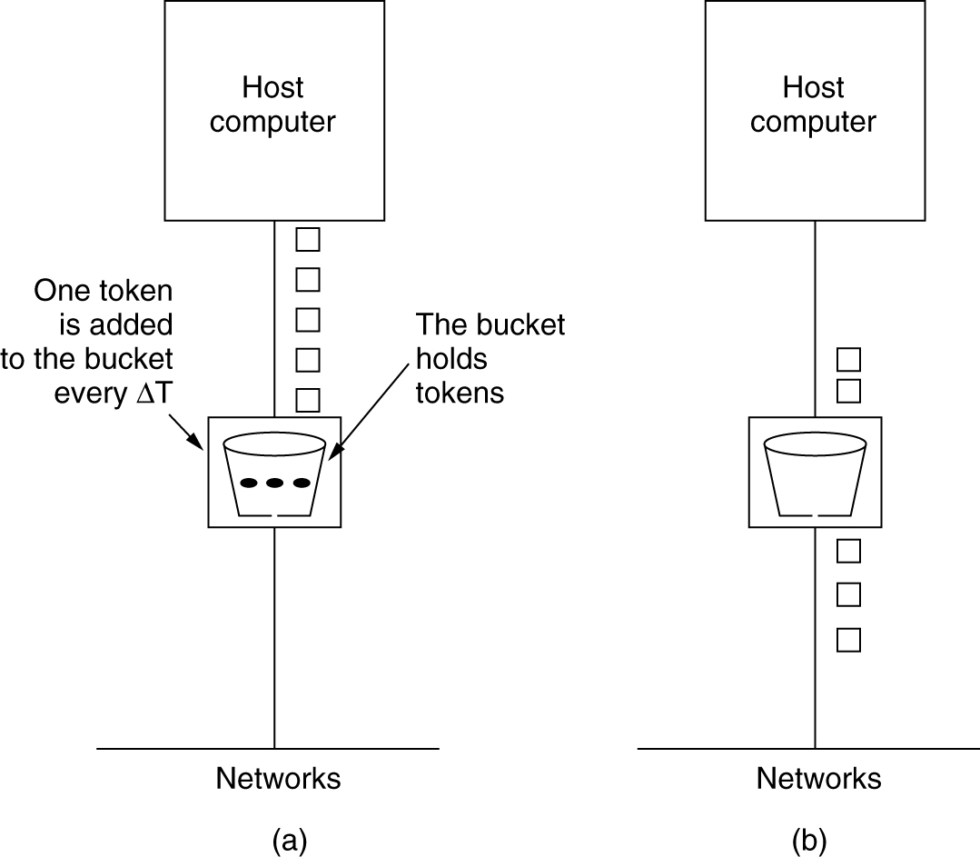
The Token Bucket Algorithm
5-34
(a) Before. (b) After.
QoS
#<number>

Slide 23
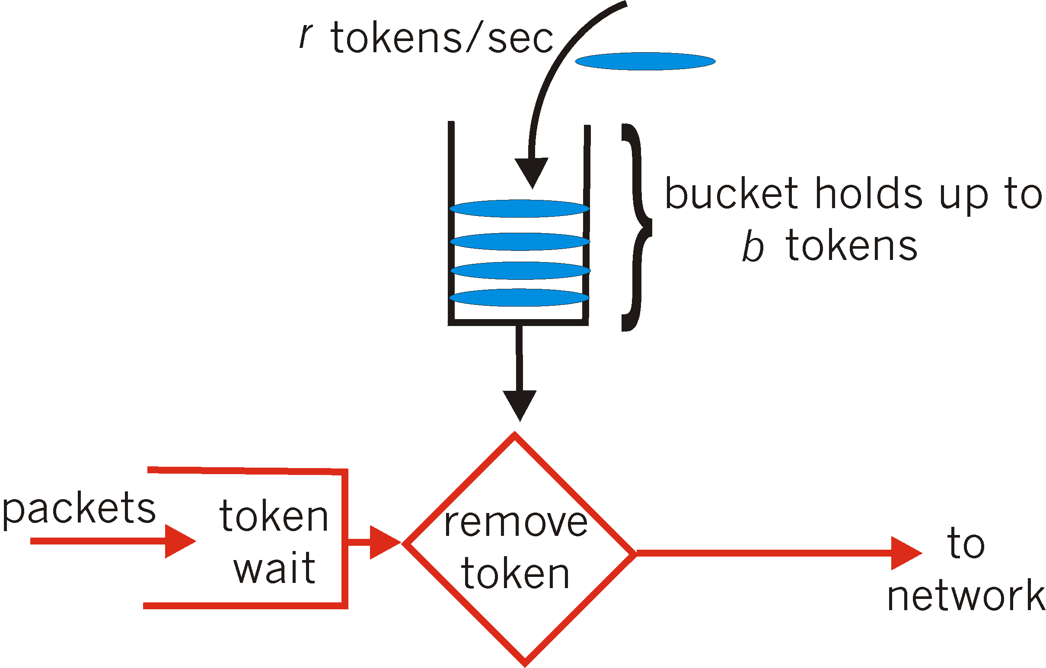
Token bucket example
arrival | queue | Token bucket | sent
p1 (5) | - | 0 | -
p2 (2) | p1 | 3 | -
p3 (1) | p2 | 6-5=1 | p1
 |  | 4-2-1=1 | p3,p2
 |  | 4
 |  | 6
parameters:
MaxTokens=6
1/r=3 (=3 token/time)
QoS
#<number>
Notes:
Need to change to start with a full bucket

Slide 24
Leaky Bucket vs Token Bucket
Leaky Bucket
Discard:
  Packets
Rate:
  fixed rate (perfect)
Arriving Burst:
  Waits in bucket
Token Bucket
Discard:
  Tokens
  Packet management separate
Rate:
  Average rate
  Bursts allowed
Arriving Burst:
  Can be sent immediately
QoS
#<number>

Slide 25
The (σ,ρ) Model
Parameters:
  The average rate is ρ.
  The maximum burst is σ.
(σ,ρ) Model:
  Over an interval of length t,
  the number of packets/bits that are admitted
  is less than or equal to (σ+ρt).
  Composing flows (σ₁,ρ₁) & (σ₂,ρ₂)
    Resulting flow (σ₁+ σ₂,ρ₁+ρ₂)
Token Bucket Algorithm:
  σ = MaxTokens & ρ=1/r per time unit
Leaky Bucket Algorithm
  σ = 0 & ρ= =1/r per time unit
QoS
#<number>

Slide 26
Using (σ,ρ) Model for admission Control
What does a router need to support streams: (σ₁,ρ₁) … (σ_{k},ρ_{k})
  Buffer size B > Σ σ_{i}
  Rate R > Σ ρ_{i}
Admission Control (at the router)
  Can support (σ_{k},ρ_{k}) if
  Enough buffers and bandwidth
    R > Σ ρ_{i} and B > Σ σ_{i}
QoS
#<number>

Slide 27
Delay Bounds: WFQ
Recall: work_{S}(i, a,b)
  # bits transmitted for flow i in time [a,b] by policy S.
Theorem (Parekh-Gallager: Single link):
  Assume maximum packet size L_{max}
  Then for any time t:
  work_{GPS}(i,1,t) - work_{WFQ}(i, 1,t) ≤ L_{max}
Corollary:
  For any packet p and link rate R
    Let Time(p,S) be its completion time in policy S
    Then Time(p,WFQ)-Time(p,GPS) ≤ L_{max}/R
QoS
#<number>

Slide 28
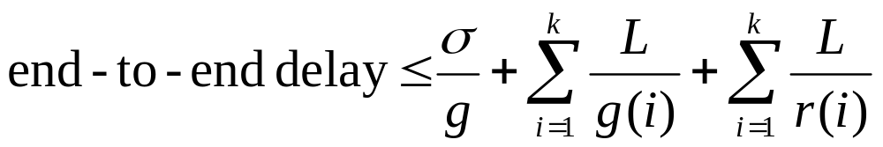
Parekh-Gallagher theorem
Suppose a given connection is (σ,ρ) constrained, has maximal packet size L, and passes through K WFQ schedulers, such that in the ith scheduler
  there is total rate r(i)
  from which the connection gets g(i).
Let g be the minimum over all g(i), and suppose all packets are at most L_{max} bits long. Then
QoS
#<number>

Slide 29
P-G theorem: Interpretation
Delay of last packet of a burst. Only in bottleneck node
Delay of last packet of a burst. Only in bottleneck node
GPS term
store&forward penalty
store&forward penalty
WFQ lag behind GPS: each node
WFQ lag behind GPS: each node
GPS to WFQ correction
QoS
#<number>

Slide 30
Significance
WFQ can provide end-to-end delay bounds
So WFQ provides both fairness and performance guarantees
Bound holds regardless of cross traffic behavior
Can be generalized for networks where schedulers are variants of WFQ, and the link service rate changes over time
QoS
#<number>

Slide 31
Fine Points
To get a delay bound, need to pick g
  the lower the delay bound, the larger g needs to be
  large g means exclusion of more competitors from link
Sources must be leaky-bucket regulated
  but choosing leaky-bucket parameters is problematic
WFQ couples delay and bandwidth allocations
  low delay requires allocating more bandwidth
  wastes bandwidth for low-bandwidth low-delay sources
QoS
#<number>

Slide 32
Approaches to QoS
Integrated Services
Network wide control
Admission Control
Absolute guarantees
Traffic Shaping
Reservations
  RSVP
Differentiated Services
Router based control
  Per hop behavior
Resolves contentions
  Hot spots
Relative guarantees
Traffic policing
  At entry to network
QoS
#<number>

Slide 33
IETF Integrated Services
architecture for providing QOS guarantees in IP networks for individual application sessions
resource reservation: routers maintain state info (a la VC) of allocated resources, QoS req’s
admit/deny new call setup requests:
Question: can newly arriving flow be admitted
with performance guarantees while not violated
QoS guarantees made to already admitted flows?
QoS
#<number>

Slide 34




Intserv: QoS guarantee scenario
Resource reservation
  call setup, signaling (RSVP)
  traffic, QoS declaration
  per-element admission control
request/
reply
  QoS-sensitive scheduling (e.g., WFQ)
QoS
#<number>

Slide 35
Call Admission
Arriving session must :
declare its QOS requirement
  R-spec: defines the QOS being requested
characterize traffic it will send into network
  T-spec: defines traffic characteristics
signaling protocol: needed to carry R-spec and T-spec to routers (where reservation is required)
  RSVP
QoS
#<number>

Slide 36
RSVP request (T-Spec)
A token bucket specification
  bucket size, b
  token rate, r
  the packet is transmitted onward only if the number of tokens in the bucket is at least as large as the packet
peak rate, p
  p > r
maximum packet size, M
minimum policed unit, m
  All packets less than m bytes are considered to be m bytes
  Reduces the overhead to process each packet
  Bound the bandwidth overhead of link-level headers
QoS
#<number>

Slide 37
RSVP request (R-spec)
An indication of the QoS control service requested
  Controlled-load service and Guaranteed service
For Controlled-load service
  Simply a Tspec
For Guaranteed service
  A Rate (R) term, the bandwidth required
    R ≥ r, extra bandwidth will reduce queuing delays
  A Slack (S) term
    The difference between the desired delay and the delay that would be achieved if rate R were used
    With a zero slack term, each router along the path must reserve R bandwidth
    A nonzero slack term offers the individual routers greater flexibility in making their local reservation
    Number decreased by routers on the path.
QoS
#<number>

Slide 38
QoS Routing: Multiple constraints
A request specifies the desired QoS requirements
  e.g., BW, Delay, Jitter, packet loss, path reliability etc
Three (main) type of constraints:
  Additive: e.g., delay
  Multiplicative: e.g., loss rate
  Maximum (or Minimum): e.g., Bandwidth
Task
  Find a (min cost) path which satisfies the constraints
  if no feasible path found, reject the connection
  Generally, multiple constraints is HARD computationally.
Simple case:
  BW and delay
QoS
#<number>

Slide 39
Example of QoS Routing
D = 4, BW = 55
D = 10, BW = 20
A
D = 5, BW = 90
B
D = 5, BW = 90
D = 5, BW = 60
D = 14, BW = 40
D = 7, BW = 90
D = 5, BW = 90
D = 10, BW = 90
D = 3, BW = 45
Constraints: Delay (D) < 25, Available Bandwidth (BW) > 30
QoS
#<number>

Slide 40
IETF Differentiated Services
Concerns with Intserv:
Scalability: signaling, maintaining per-flow router state difficult with large number of flows
Flexible Service Models: Intserv has only two classes. Also want “qualitative” service classes
  “behaves like a wire”
  relative service distinction: Platinum, Gold, Silver
Diffserv approach:
simple functions in network core, relatively complex functions at edge routers (or hosts)
Don’t define service classes, provide functional components to build service classes
QoS
#<number>

Slide 41

Diffserv Architecture
Edge router:
- per-flow traffic management
- marks packets as in-profile and out-profile
marking
r
scheduling
.
b
.
.
Core router:
- per class traffic management
- buffering and scheduling
based on marking at edge
- preference given to in-profile
packets
QoS
#<number>

Slide 42
Edge-router Packet Marking
profile: pre-negotiated rate A, and token bucket size B
packet marking at edge based on per-flow profile
Rate A
B
User packets
Possible usage of marking:
class-based marking: packets of different classes marked differently
intra-class marking: conforming portion of flow marked differently than non-conforming one
QoS
#<number>

Slide 43

Classification and Conditioning
Packet is marked in the Type of Service (TOS) in IPv4, and Traffic Class in IPv6
6 bits used for Differentiated Service Code Point (DSCP) and determine PHB that the packet will receive
2 bits are currently unused
QoS
#<number>

Slide 44
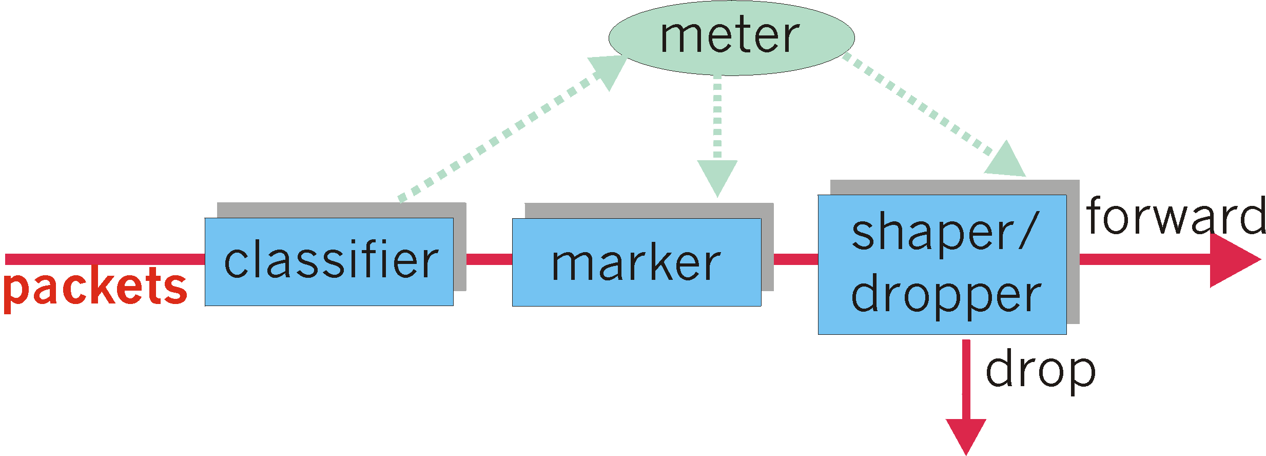
Classification and Conditioning
It may be desirable to limit traffic injection rate of some class; user declares traffic profile (eg, rate and burst size); traffic is metered and shaped if non-conforming
QoS
#<number>

Slide 45
Forwarding (PHB)
Per Hop Behavior (PHB) result in a different observable (measurable) forwarding performance behavior
PHB does not specify what mechanisms to use to ensure required PHB performance behavior
Examples:
  Class A gets x% of outgoing link bandwidth over time intervals of a specified length
  Class A packets leave first before packets from class B
QoS
#<number>

Slide 46
Forwarding (PHB)
PHBs being developed:
Expedited Forwarding: pkt departure rate of a class equals or exceeds specified rate
  logical link with a minimum guaranteed rate
    Premium service
  DSCP = 101110 (46)
Assured Forwarding: 4 classes of traffic
  each guaranteed minimum amount of bandwidth
  each with three drop preference partitions
    Gold, silver, bronze
QoS
#<number>

Slide 47




DiffServ Routers
DiffServ
Edge
Router
Classifier
Marker
Meter
Policer
DiffServ
Core
Router
PHB
Select PHB
PHB
Local
conditions
PHB
PHB
Extract
DSCP
Packet
treatment
QoS
#<number>
Notes:
DiffServ edge router utilises these functions in order to perform its task:
- Classification (based on for example application, user or load)
- Marking (of the DiffServ packets)
- Metering (for policing or marking purposes)
- Policing (handling of non-conformant traffic)
DiffServ core router will treat an IP packet based on
1) DS codepoint
2) Local conditions
DS codepoint is actually an index to a table that contains so called Per Hop Behaviors (PHB).
Per Hop Behavior is the set of rules how the packet (or actually the aggregate flow that the packet belongs to) is treated.
The local conditions can be, for example, the occupancy level(s) of the buffer(s) of the router.
Based on these two pieces of information, the edge router treats the packet.
For example, the packet may be discarded or accepted for buffering.

Slide 48

IntServ vs. DiffServ
IP
DSCP
IP
IntServ network
DiffServ network
"Call blocking" approach
"Prioritization" approach
QoS
#<number>
Notes:
This figure illustrates the basic principles of Integrated Services and Differentiated Services methods.
With Integrated Services -method the network creates "bit pipes" through the IP network.
If there is congestion, the user does not get such a bit pipe.
With Differentiated Services method the idea is to equip the IP packet with some priorities. Effectively, these provide IP packets with different capabilities to "fight" their way through the congestion points of the network.
If there is congestion, the packets with poor priorities will be discarded first. However, the user may always get at least something through.

Slide 49
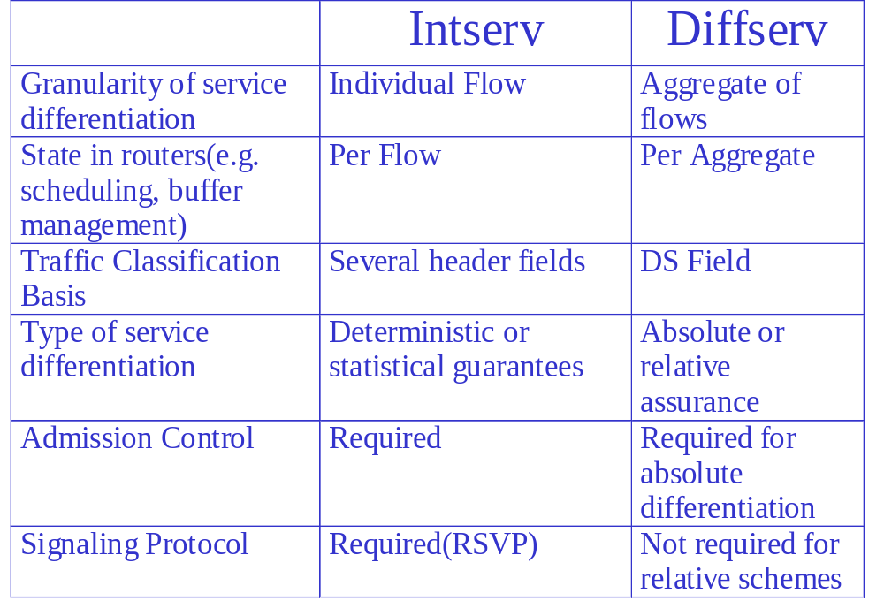
Comparison of Intserv & Diffserv Architectures
QoS
#<number>

Slide 50
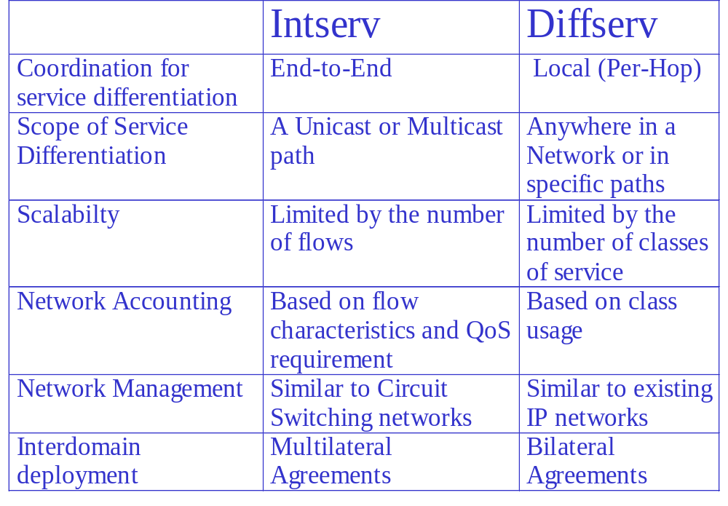
Comparison of Intserv & Diffserv Architectures
QoS
#<number>

